Slide 1
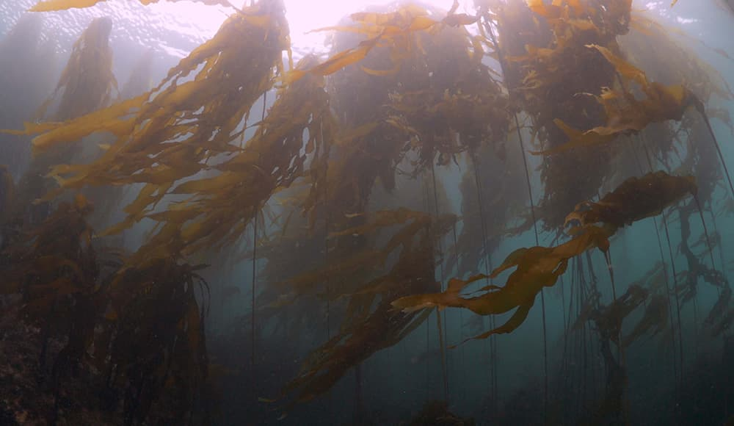
Kelp Restoration in Greater Farallones National Marine Sanctuary
Rietta Hohman
Greater Farallones National Marine Sanctuary, NOAA Affiliate
Greater Farallones Association
Kelp Restoration Network Meeting, July 28, 2022
Paul Chetirkin NOAA MBNMS
Notes:
1

Slide 2
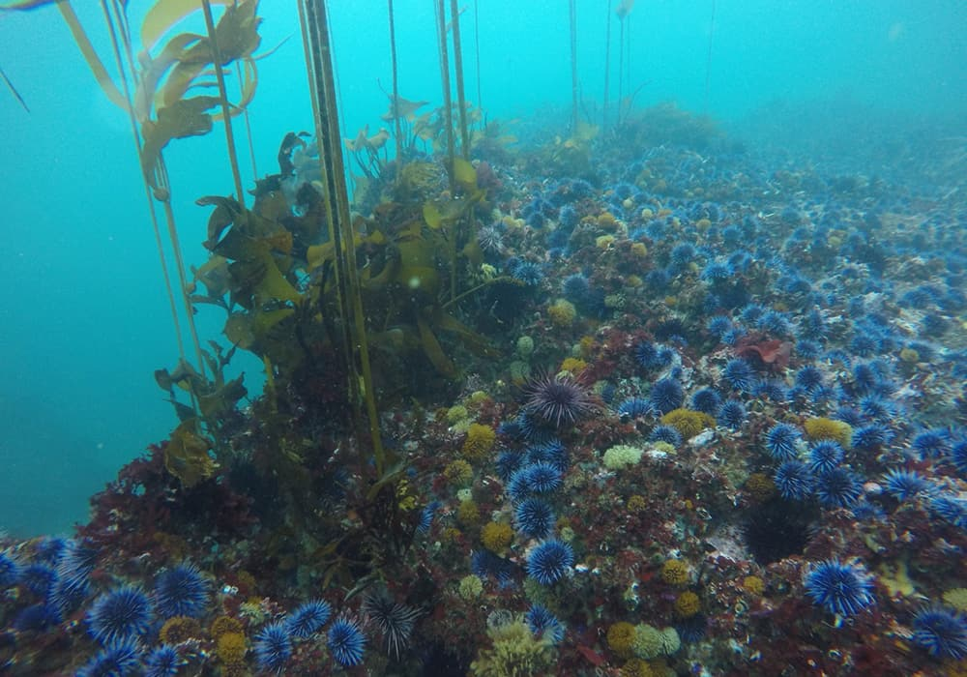
Outline
State of kelp forests in the sanctuary (as of 2021)
2021 restoration site assessment
Funding awarded to restore kelp in the sanctuary
Identified sites
Methods and Assessment
Proposed Restoration and Research
Outreach and Engagement
Next Steps
Steve Lonhart NOAA MBNMS
Notes:
2

Slide 3

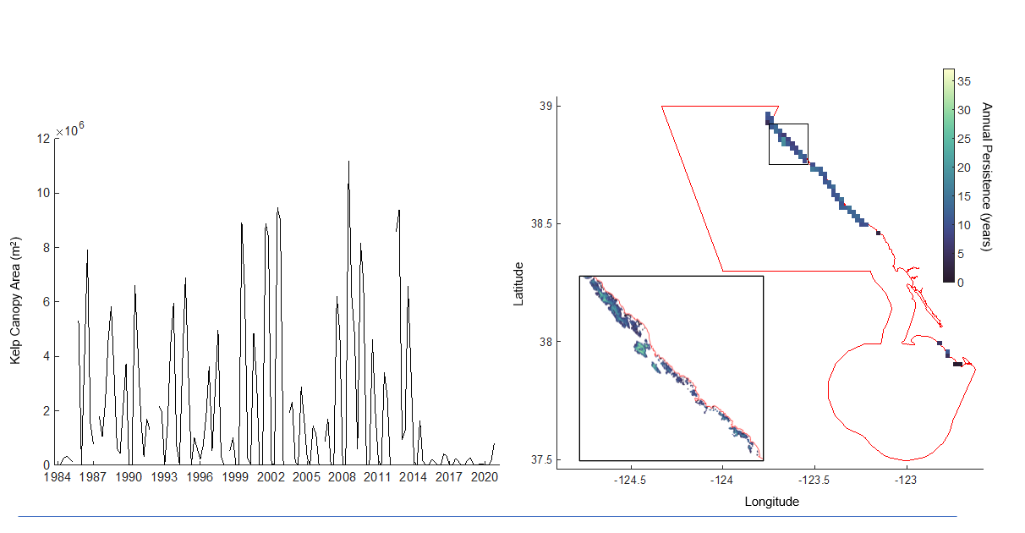
Current state of kelp forests in GFNMS
Severe persistent loss over the last eight years
Very little increase in kelp cover in 2021 compared to historical persistence
Limited kelp growth in Sonoma in 2022
Data: T. Bell
Hohman et al. in development
Notes:
3
Seasonal time series of kelp canopy area for the GFNMS from 1984 – 2020, seasons with no data indicated that imagery was not available or that all images were cloud contaminated for that 3-month period. Map showing the mean persistence (number of years kelp canopy was present from 1984 – 2020) inside each 2 x 2 km cell. Red line shows the boundaries of the sanctuary. Inset (area within the black box) shows the persistence of kelp canopy at the native 30-meter resolution of the imagery.

Slide 4
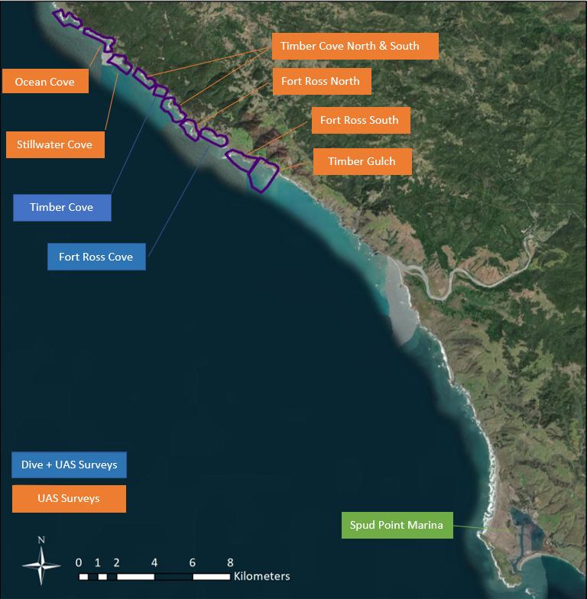
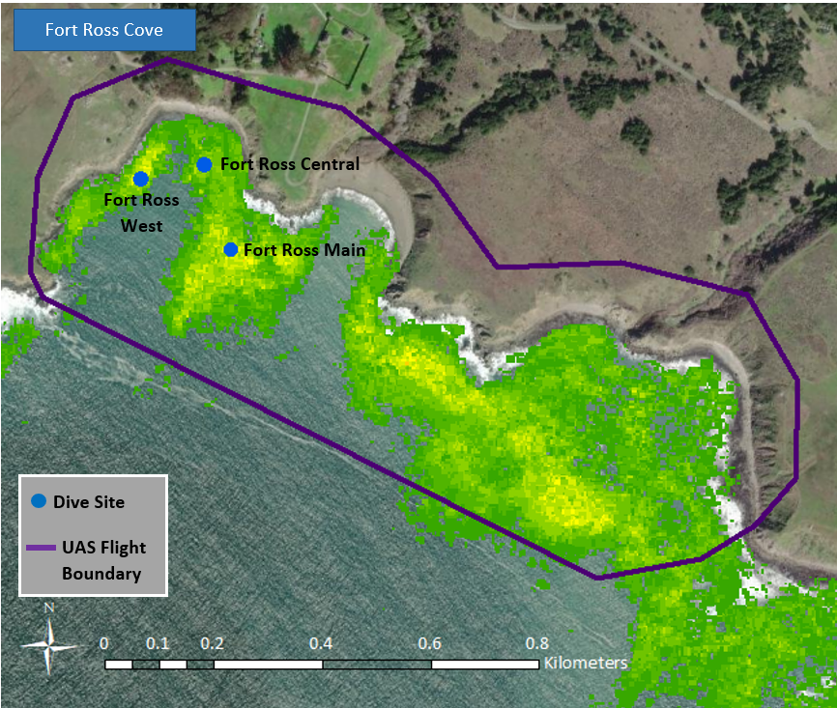
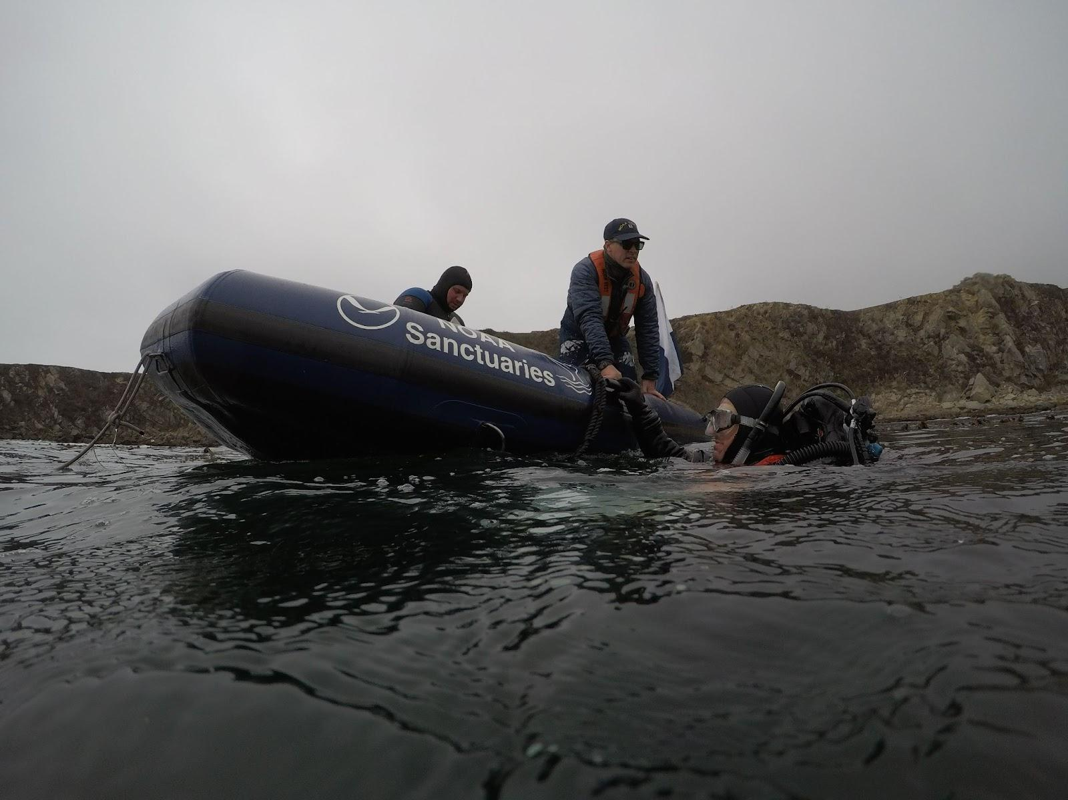
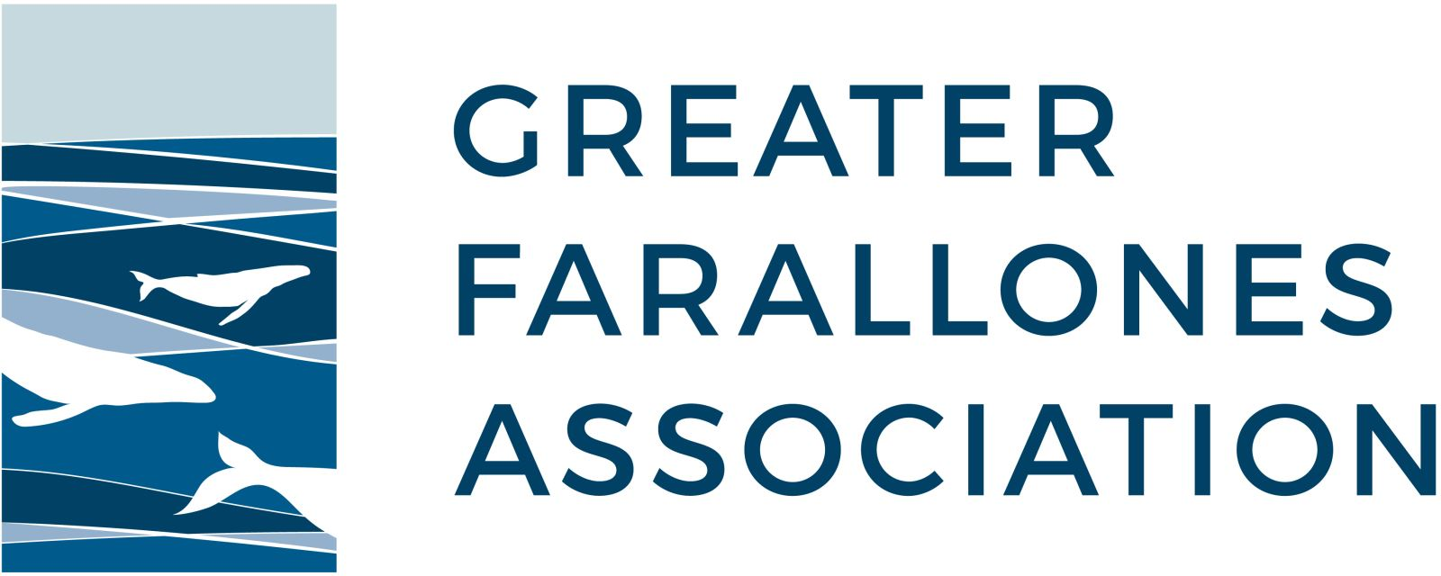
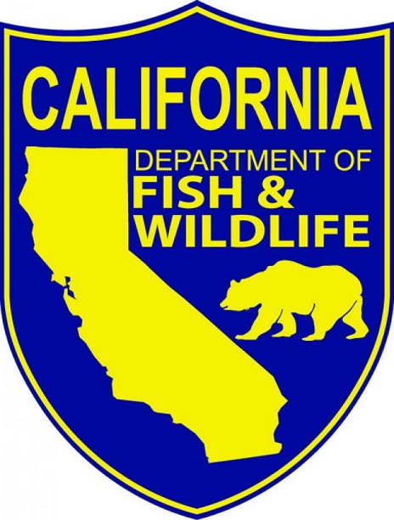
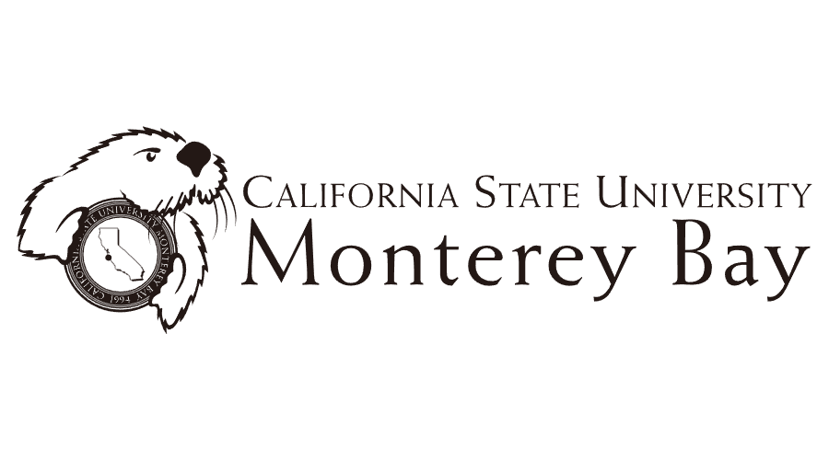
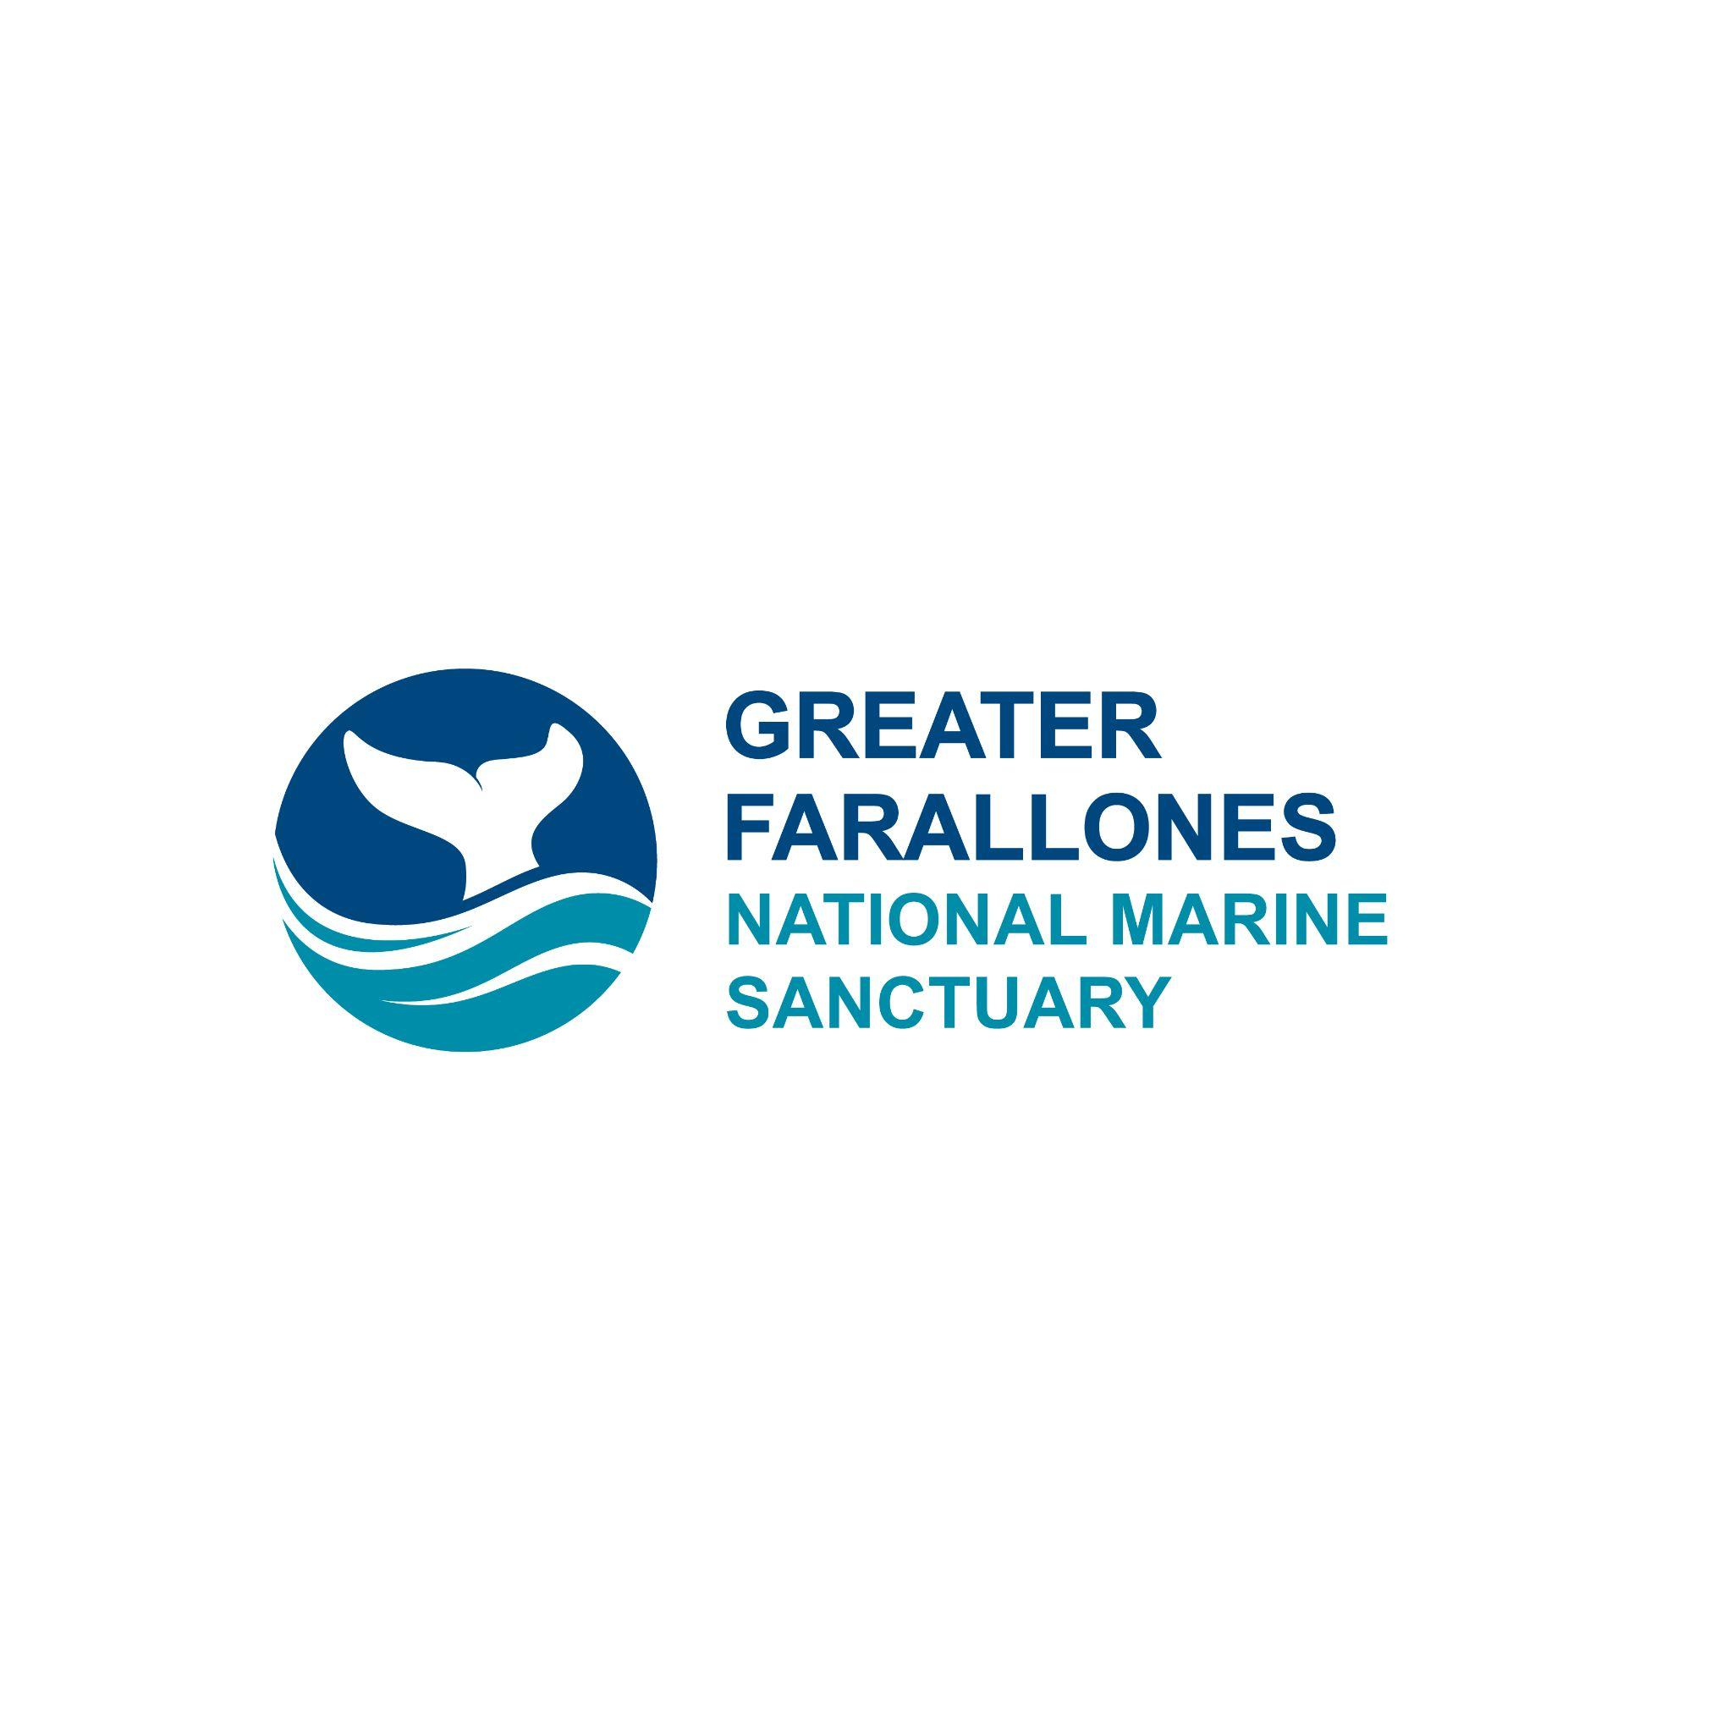
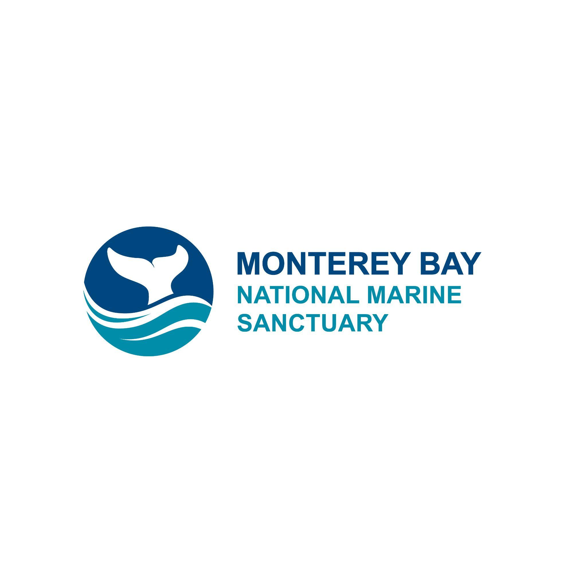
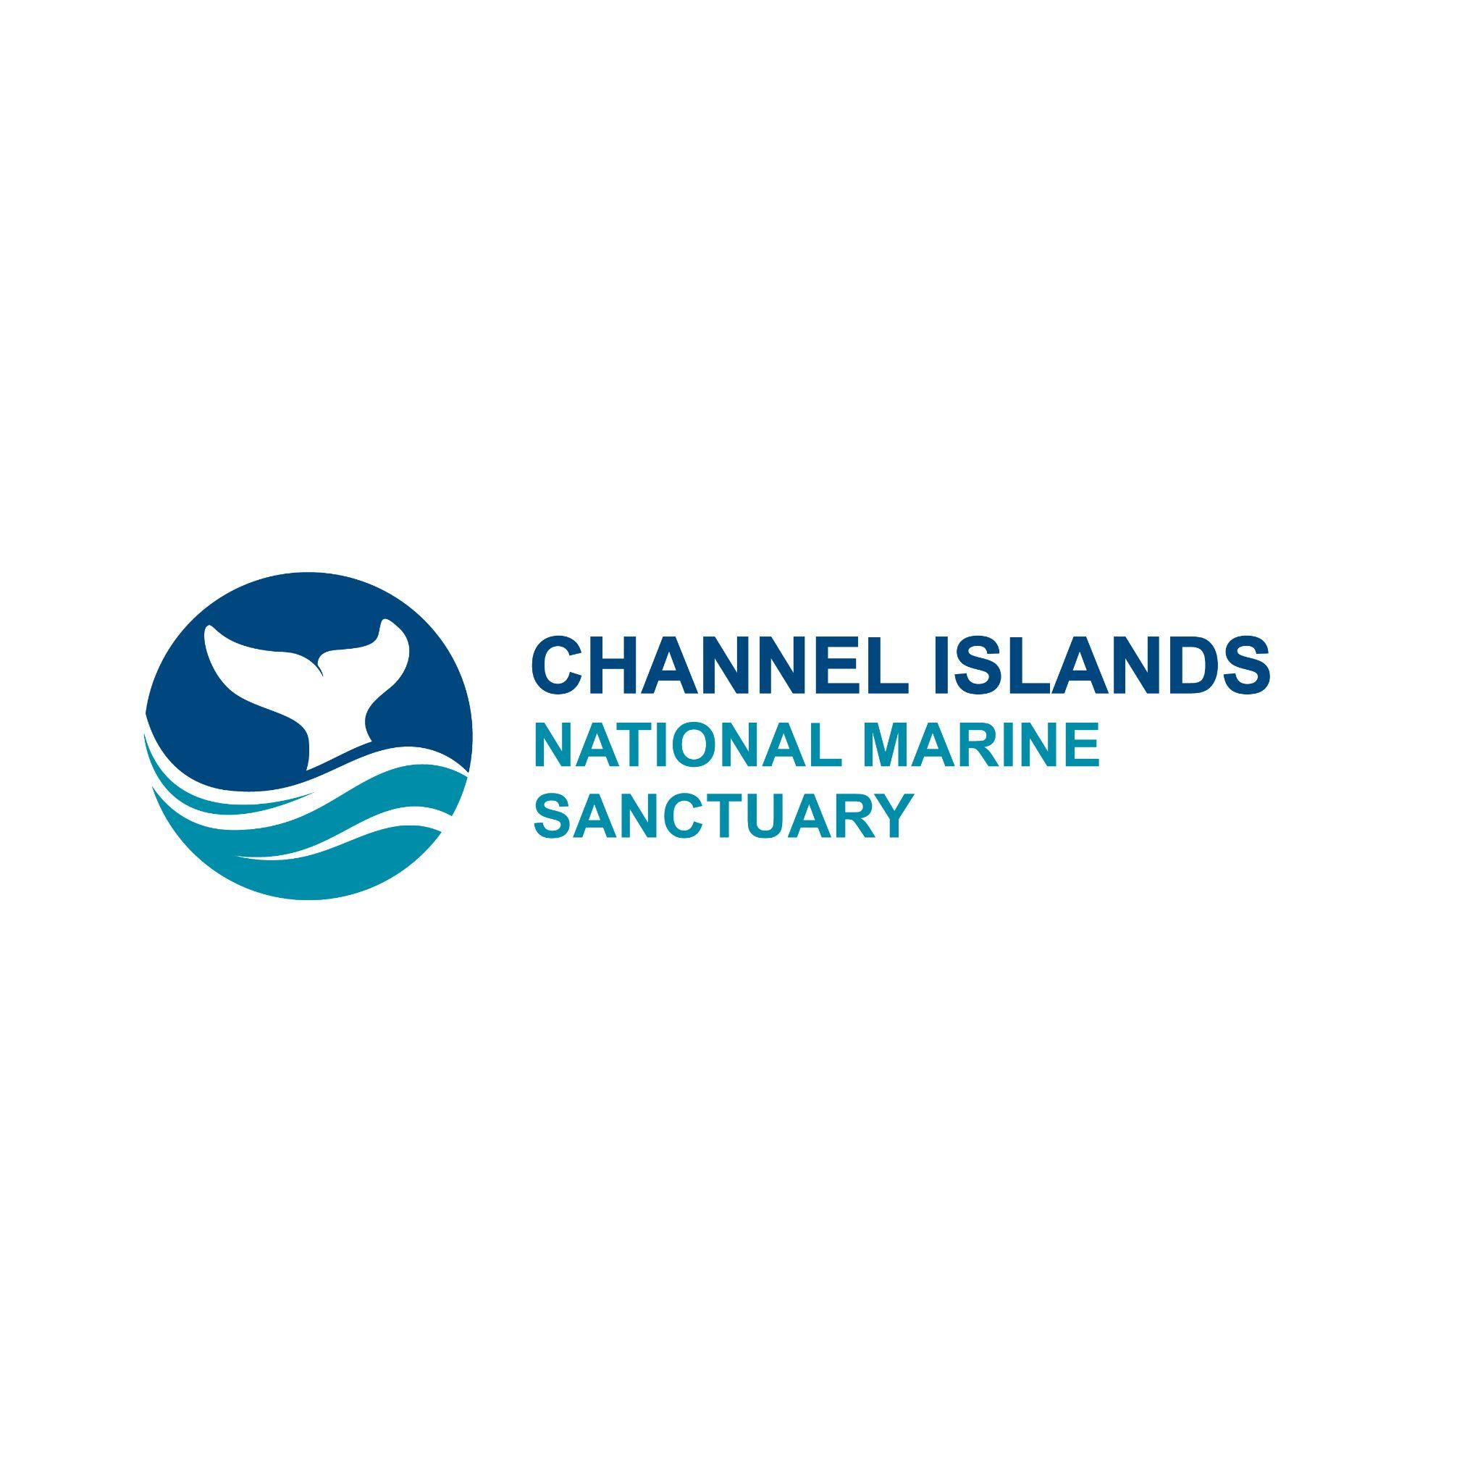
Restoration Site Assessment 2021
Steve Lonhart NOAA MBNMS
Notes:
4

Slide 5
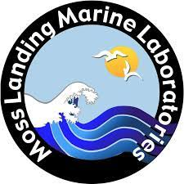

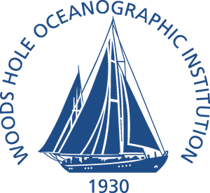
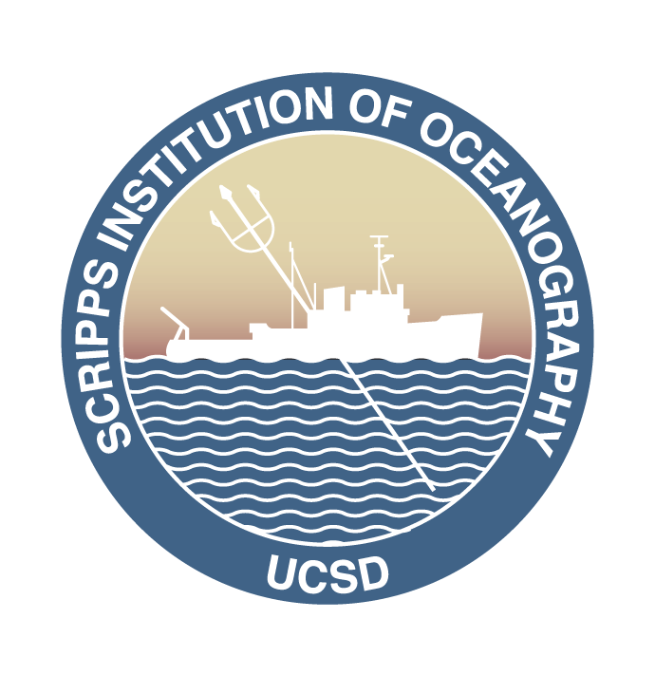

Funding awarded to restore kelp forests in the sanctuary
Funding Source | Amount | Scope of Work | Timeline
NOAA (federal appropriations) | $2,000,000 | Build infrastructure for dive capacity, initiate restoration at Fort Ross | August 2022 - September 2026
Pacific States Marine Fisheries Commission | $228,912 | Defend kelp forest growth at identified sites in the sanctuary | June 2022 - June 2024
National Fish and Wildlife Foundation | $184,473 | Investigate interconnectivity of estuarine and kelp forest habitats, habitat suitability for outplanting in Drake’s Bay | April 2022 - March 2024
Environmental Enhancement Fund | $173,642 | Conduct urchin removals, outplanting & research at Timber Cove | April 2023 - March 2025
Total $ for restoration, monitoring and research | $2,587,027 | Restoration and research across four identified sites | 2022-2026
Notes:
5

Slide 6
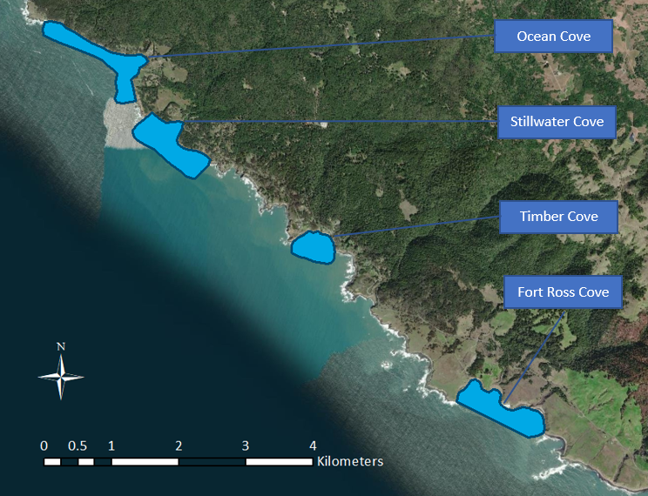
Identified Sites
Sites identified in Sonoma-Mendocino Bull Kelp Restoration Plan following recommendations from Greater Farallones Sanctuary Advisory Council
Notes:
Give overview of GF SAC meetings
6

Slide 7
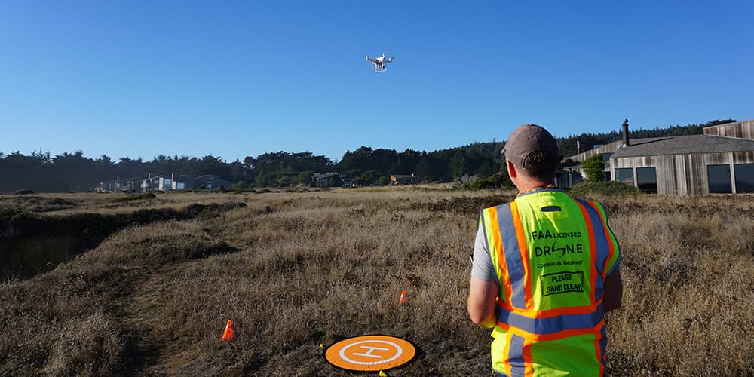
Monitoring and Assessment
Establish restoration sites
Conduct before/after kelp forest ecosystem health surveys
Assess efficacy of restoration efforts
Map bull kelp canopy with UAS
Abby Nickels
Notes:
7

Slide 8
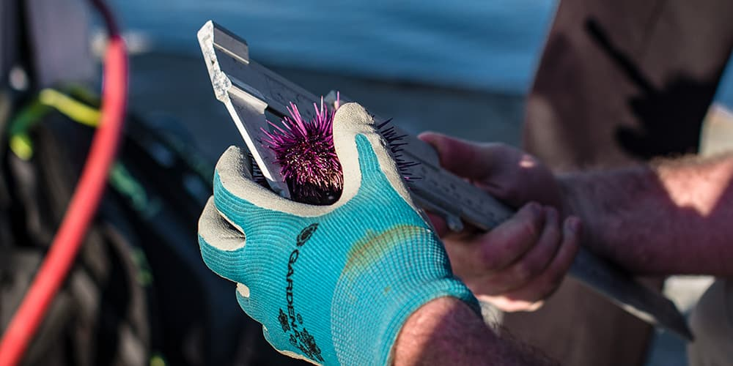
Proposed Restoration and Research
Remove urchin and outplant kelp at identified sites
Defend new kelp forest growth
Identify habitat suitability for outplanting
Characterize the influence of environmental variables on kelp settlement and growth
Nick Zachar NOAA
Notes:
8

Slide 9
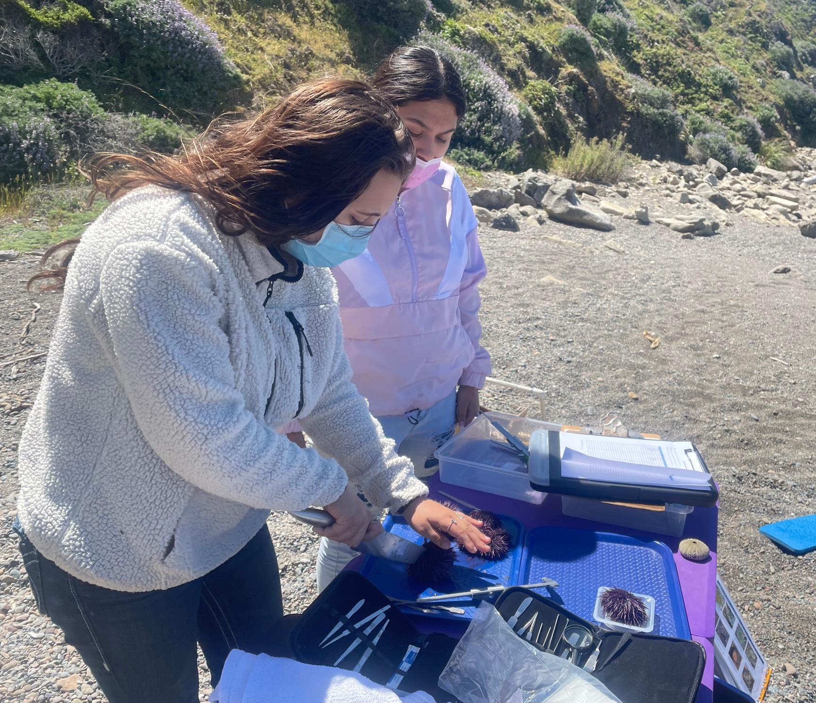
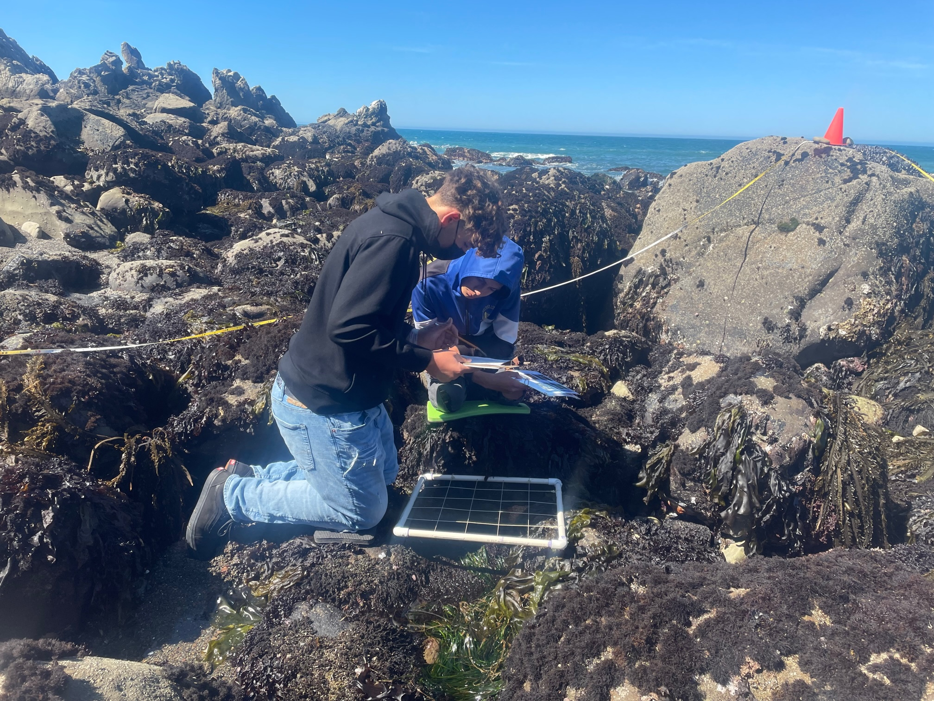
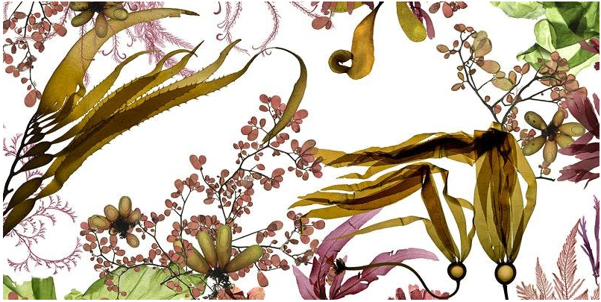
Outreach and Engagement
Community engagement on proposed research and restoration implementation
Greater Farallones Sanctuary Advisory Council Meetings
Launch of Kelp Restoration Network on July 28, coordinated by Jordan Gorostiza at Kelp! Art exhibition in San Francisco at 836M
New youth kelp education programs funded by NOAA in Mendocino and Sonoma for classroom programs, intertidal monitoring and urchin removals
GFA-GFNMS
Josie Iselin
Notes:
9

Slide 10
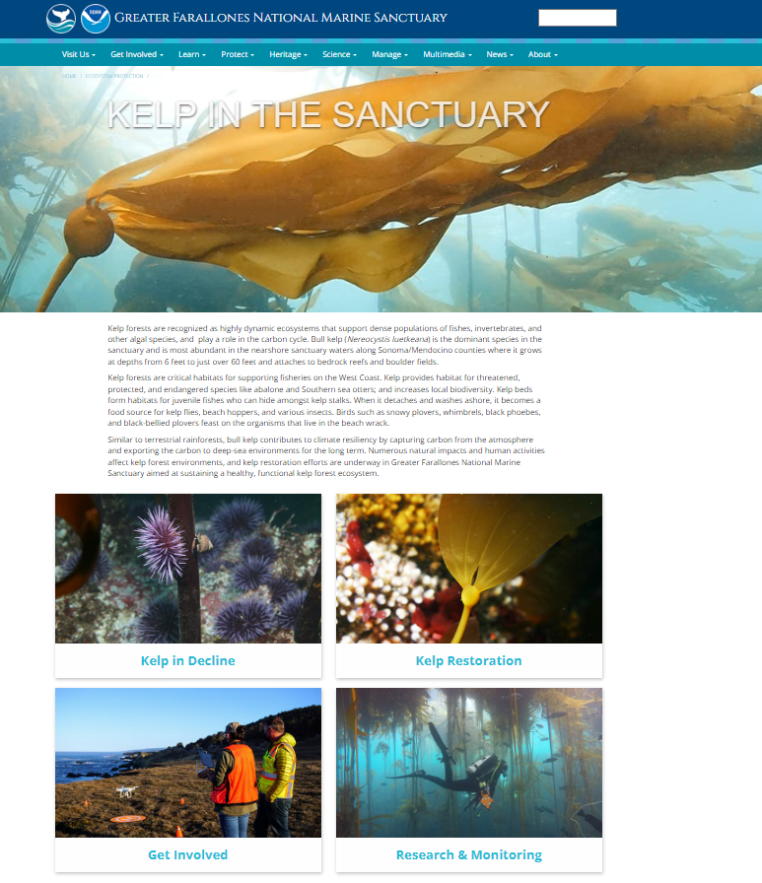
Notes:
10

Slide 11
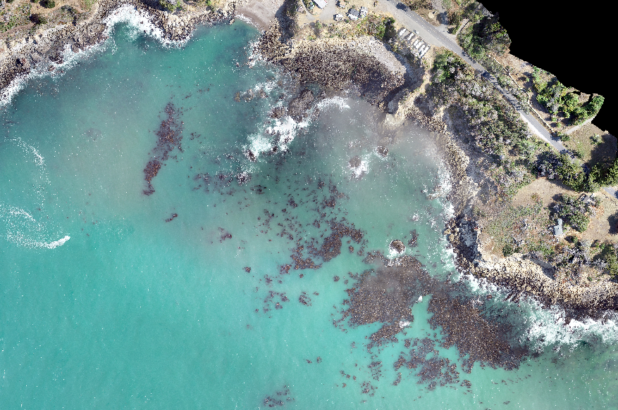
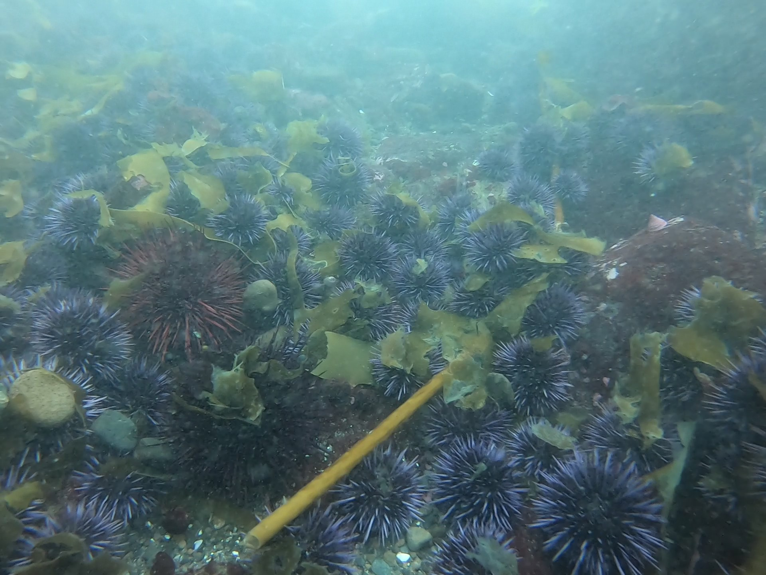
Next Steps in 2022
Tribal engagement
Permitting & compliance
Restoration and research cruise in Drake’s Bay aboard the R/V Fulmar
Sonoma restoration assessment cruise aboard the R/V Fulmar
Kelp canopy surveys
Scale up restoration efforts in 2023
GFNMS-GFA, CDFW

Slide 12
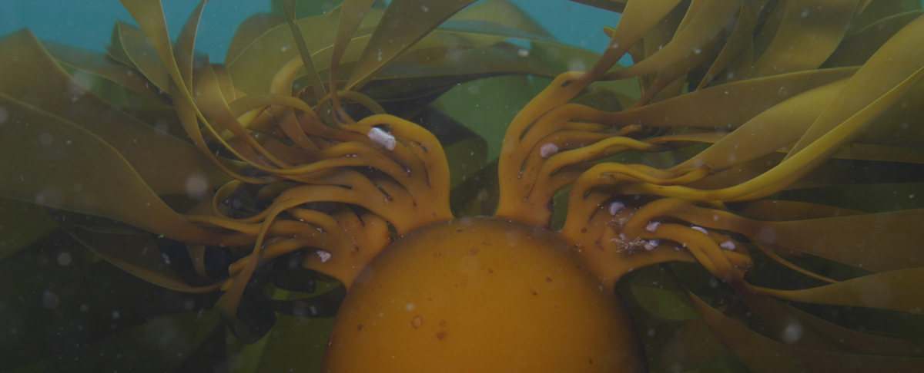
Next Steps
Questions?
Rietta Hohman
Rietta.Hohman@noaa.gov
(415)761-0963
www.farallones.noaa.gov/eco/kelp
www.farallones.org/climate/kelp
Notes:
12

